Slide 1
Chapter 12:
Reproduction produces offspring

Slide 2
12.1 Fertilisation
Sexual intercourse
For fertilisation to occur, male sperm need to be brought into contact with an ovum produced by the female. The usual method is sexual intercourse. For sexual intercourse to take place, and for sperm to be deposited in the vagina, the penis must become become erect. An erection results from blood rushing into the spaces of the erectile tissue of the penis.
Rhythmic contractions of the epididymis, vasa deferentia, seminal vesicles and prostate gland propel the contents of the ducts and glands into the urethra and then out of the body. This process is called ejaculation. The ejaculated material consists of semen, which contains sperm.
Semen also contains the secretions of the seminal vesicles, bulbo-urethral glands and prostate gland. The greatest contribution comes from the seminal vesicles, which produce a thick fluid containing nourishment for the sperm. Besides nourishment, semen provides the sperm with a fluid in which to swim, and neutralises the acid nature of the male urethra and female vagina. In addition, it contains enzymes that activate the sperm once ejaculation has taken place.

Slide 3
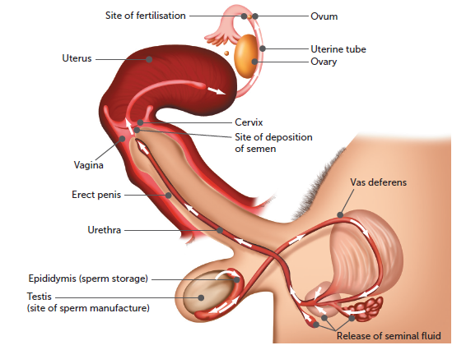
12.1 Fertilisation
The pathway taken by sperm during sexual intercourse

Slide 4
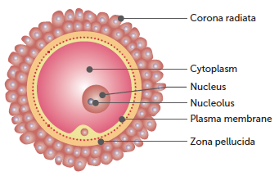
12.1 Fertilisation
Fertilisation
The sperm are released in the vagina at the entrance to the uterus; a process called insemination. Once within the vagina, the sperm travel through the cervix and the body of the uterus into the uterine tubes.
Of the hundreds of millions of sperm deposited into the vagina during sexual intercourse, only a few thousand reach the uterine tubes. Fertilisation normally occurs in the uterine tubes when the ovum is about one-third of the way down the tube.
The secondary oocyte that is released at ovulation is at metaphase II.
It is surrounded by two layers.
The outer corona radiata consists of follicle cells held together by cementing materials that contain acid.
The inner zona pellucida is a glycoprotein matrix surrounding the plasma membrane of the oocyte.

Slide 5
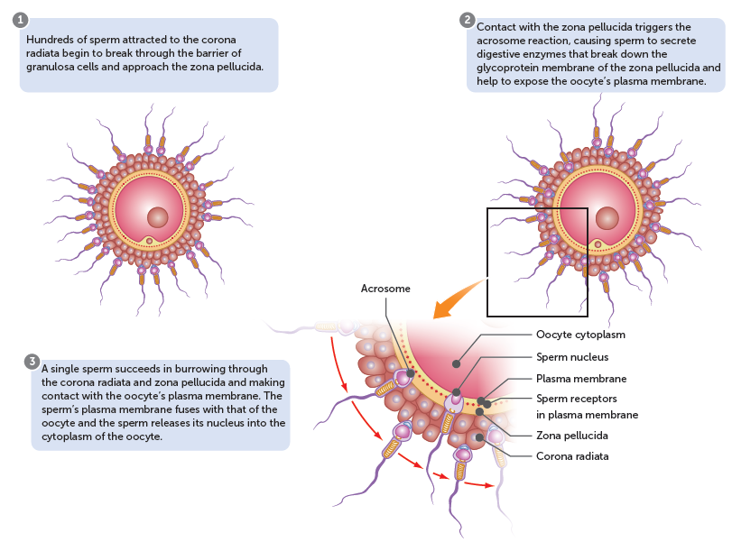
12.1 Fertilisation
Process of fertilisation

Slide 6
12.1 Fertilisation
Once the sperm has entered the oocyte the tail is absorbed, and the head begins to move through the cytoplasm in the form of a male pronucleus – the haploid nucleus of the sperm. The entrance of the sperm stimulates the secondary oocyte to complete the second meiotic division. The nucleus of the oocyte develops into a female pronucleus (a haploid nucleus of the oocyte), which fuses with the male pronucleus to form a single nucleus that now has the diploid number of chromosomes.
Fertilisation is complete, and the fertilised oocyte is called a zygote.

Slide 7
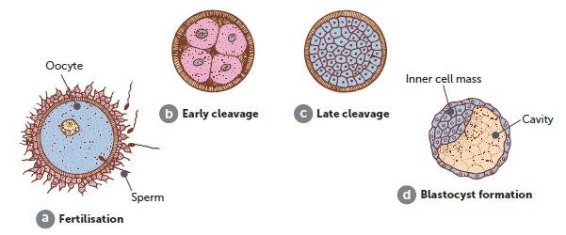
12.2 Early embryonic development and implantation
Blastocyst formation
After fertilisation, the zygote travels down the uterine (or Fallopian) tube and begins to divide by mitosis. The process of mitosis results in the formation of two cells exactly the same as the original parent cell. These two cells divide again by mitosis into four, then eight, then 16, and so on. By about six days after fertilisation, the original zygote has reached the uterus and has developed into a blastocyst. The blastocyst is a hollow ball of cells that surround a cavity filled with fluid. At one side of the cavity is a group of about 30 cells called the inner cell mass. The inner cell mass is composed of stem cells that will differentiate into the different body cells to form the embryo.

Slide 8
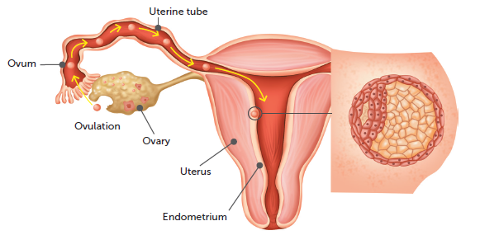
12.2 Early embryonic development and implantation
Implantation
The blastocyst remains free within the cavity of the uterus for 2–3 days, and then sinks into the soft endometrium to become firmly attached to the wall of the uterus. This process is called implantation, and enables the blastocyst to gain nourishment for growth and development by absorbing nutrients from the glands and blood vessels of the uterine lining.
Implantation of a blastocyst

Slide 9
12.2 Early embryonic development and implantation
Hormone production
The continued development of the blastocyst depends on the endometrium being maintained. High levels of oestrogen and progesterone in the blood stop the endometrium breaking down, and so the menstrual cycle ceases. During the early stages of pregnancy, it is the corpus luteum that produces these hormones until the developing placenta can take over the role after approximately 8–12 weeks.
The first two months of pregnancy are referred to as the embryonic period; after the second month, the developing individual is called a foetus.

Slide 10
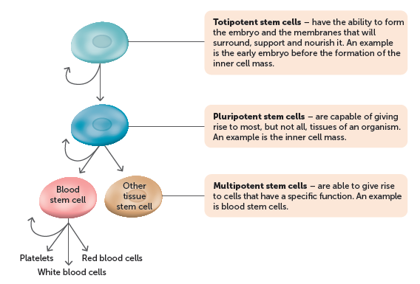
12.2 Early embryonic development and implantation
Cell differentiation
The cells that make up the inner cell mass of the blastocyst are stem cells.
After a sperm fertilises an oocyte, a zygote is formed. A zygote develops from an unspecialised totipotent cell to a blastocyst, and then to an embryo and its membranes.
Process of cell differentiation

Slide 11
12.2 Early embryonic development and implantation
Primary germ layers
While the blastocyst is implanting in the lining of the uterus, during the third week of development, the inner cell mass undergoes changes as the cells change to multipotent. This process results in the formation of three layers of cells, the primary germ layers. These layers, called the ectoderm, mesoderm and endoderm, are the embryonic tissues that will differentiate into all the tissues and organs of the body.

Slide 12
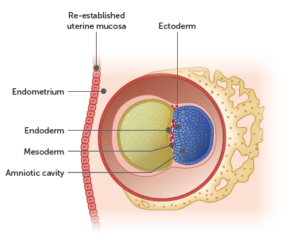
12.2 Early embryonic development and implantation
Ectoderm
The outermost germ layer. This will form the outer layers of the body, such as the skin, hair and mammary glands, as well as the nervous system.
Mesoderm
The middle germ layer. The skeleton, muscles, connective tissue, heart, blood and urogenital tract form from the mesoderm. The mesoderm also allows the formation of the stomach and intestines.
Endoderm
The innermost germ layer. It forms the lining of the digestive system as well as the lungs and thyroid.

Slide 13
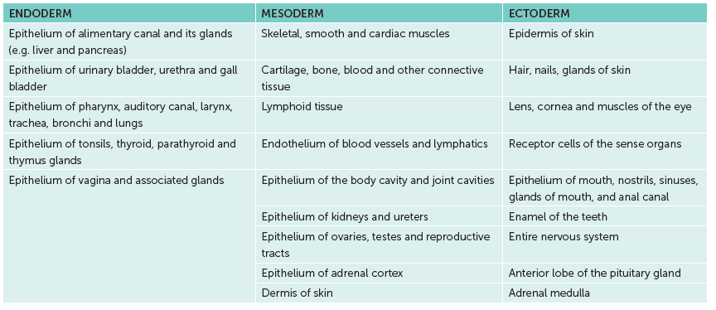
12.2 Early embryonic development and implantation
Structures formed by the three primary germ layers

Slide 14
12.2 Early embryonic development and implantation
Embryonic membranes
Early in the embryonic period, four embryonic membranes form. These lie outside the embryo and serve to protect and nourish it as it develops.
Amnion: first membrane to develop. By the eighth day after fertilisation, it surrounds the embryo, enclosing a cavity into which it secretes amniotic fluid. This fluid serves to protect the embryo against physical injury by acting as a shock absorber, helps to maintain a constant temperature and allows the developing embryo, and later the foetus, to move freely.
Chorion: formed from the outer cells of the blastocyst together with a layer of mesodermal cells, it surrounds the embryo and the other three embryonic membranes. As the amnion enlarges, it fuses with the inner layer of the chorion. Eventually, the chorion becomes the main part of the foetal portion of the placenta.
Yolk sac and allantois: form the outer structure of the umbilical cord.

Slide 15
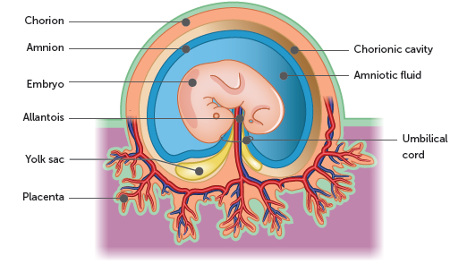
12.2 Early embryonic development and implantation

Slide 16
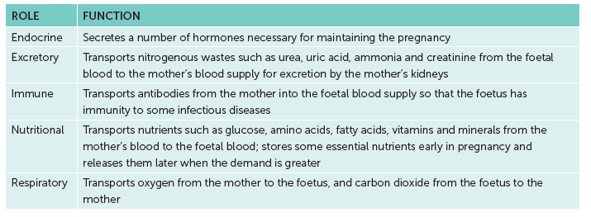
12.2 Early embryonic development and implantation
Development of the placenta
The placenta connects the embryo, or foetus, and the mother, allowing the mother to meet the needs of the baby.
Functions of the placenta

Slide 17
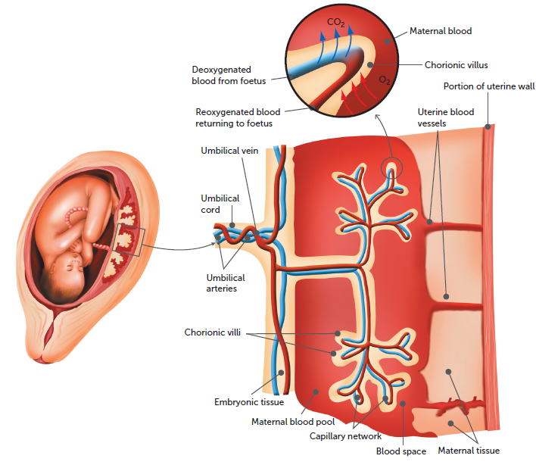
12.2 Early embryonic development and implantation
The placenta is attached to the foetus by the umbilical cord. Inside the umbilical cord are two umbilical arteries that carry blood to the capillaries of the chorionic villi. A single umbilical vein carries blood from the placenta, through the umbilical cord, back to the foetus.
On the maternal side, blood from the mother enters the placenta through the uterine arteries, flows through the blood spaces where the exchange of substances occurs, and leaves again through the uterine veins.
Functions of the placenta

Slide 18
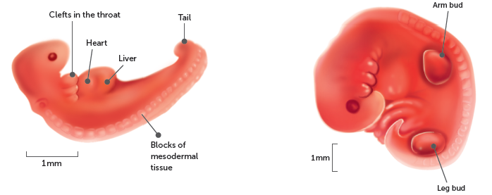
12.3 Pregnancy
From embryo to foetus
The period of pregnancy is called gestation. The developing child grows to a length of about 50 cm and to an average weight of 3400 g. This growth and development takes about 280 days.
The embryonic period forms the first 8 weeks.
By the end of this period, the general body form of the infant has developed, and the basic plan of the organ systems is in place. The developing baby is now known as a foetus.
Embryo during the fourth and fifth weeks

Slide 19
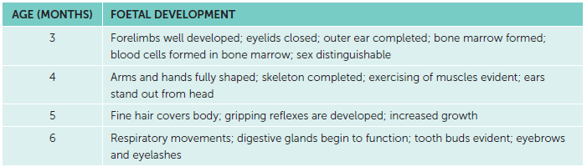

12.3 Pregnancy
Stages of foetal development

Slide 20
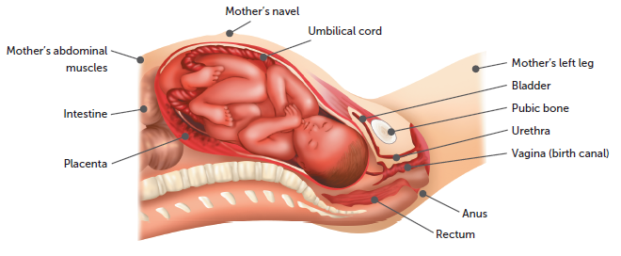
12.4 Changes during birth
The birth process
Prior to birth
In preparation for labour, several hormonal changes occur. These changes cause the ligaments of the pelvis to soften, making them more pliable for childbirth. The hormonal changes also increase the response of the uterus to stimuli and strengthen contraction of its muscles.
The foetus usually settles with its head in the mother’s pelvis.
The foetus just before birth

Slide 21
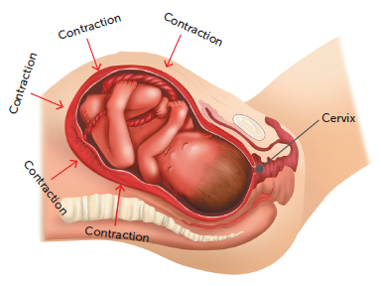
12.4 Changes during birth
First stage of labour
Strong contractions of the uterus every ~30 minutes begin the birth process. The first stage of labour, the dilation of the cervix, is the time from the onset of labour to the complete dilation (or opening) of the cervix.
As the contractions become more frequent and stronger, the head of the foetus is pushed more forcefully against the slowly dilating cervix. Eventually the cervix is completely dilated (usually to about 10 cm), and the uterus, cervix and vagina form the birth canal.

Slide 22
12.4 Changes during birth
Second stage of labour
The second stage of labour involves the delivery of the foetus. It frequently begins with the bursting of the membrane surrounding the foetus and a gush of fluid from the vagina.
As the foetus moves through the fully dilated cervix, its head stretches the vagina. This distension of the vagina stimulates the woman to contract her abdominal muscles. These contractions, together with the contractions of the uterus, push the foetus through the vagina.
Once the head has emerged, it turns sideways again to face the mother’s hips. This rotation allows the shoulders and the rest of the body to move more easily through the birth canal.

Slide 23
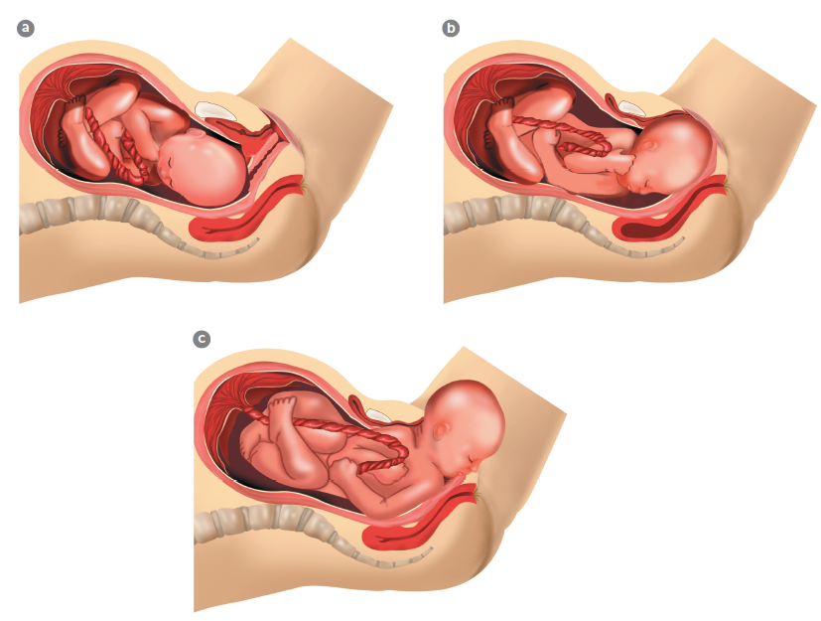
12.4 Changes during birth
a Early in the second stage of labour: the baby’s head is starting to turn so that it faces towards its mother’s back and the amnion has ruptured; b Late in the second stage: the baby’s head appears at the entrance to the vagina and its shoulders are turning to fit into the bones of the pelvis; at this stage, the face is turned completely towards the mother’s back; c The baby’s head emerges from the vagina

Slide 24
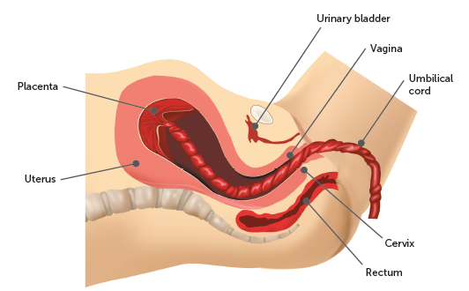
12.4 Changes during birth
Third stage of labour
Once born, the baby begins to breathe with its own lungs, even though it is still connected to the placenta by the umbilical cord. The amnion, chorion and placenta are still inside the uterus at this stage. The umbilical cord is removed.
The uterus continues to contract, and about five minutes after delivery the placenta, other membranes and the remains of the umbilical cord are expelled. Together these are called the afterbirth.

Slide 25
12.4 Changes during birth
Changes in the baby at birth
At birth, the newborn can no longer depend on the placenta for food and oxygen. The lungs and liver must now become fully functional, and for this to occur blood must flow through them. Therefore, it is important that the ductus venosus, ductus arteriosus and foramen ovale close.
As the lungs expand after birth, they no longer offer the same resistance to blood flow, so blood flow through the ductus arteriosus begins to decrease. A few weeks after the birth, all that is left of the ductus arteriosus is some fibrous tissue.

Slide 26
12.4 Changes during birth
As larger amounts of blood return to the heart from the lungs, the pressure in the left atrium increases. This increased pressure forces the flap of the foramen ovale against the wall of the atrium, closing off the opening. Eventually, the foramen ovale becomes permanently closed.
With the cutting of the umbilical cord, blood no longer flows through the umbilical vessels or the ductus venosus. As no blood is being carried through it, the ductus venosus gradually constricts until it is permanently closed off. The bypass around the liver is then lost and all blood in the blood vessel to the liver must pass through the liver.

